Slide 1



SMART INDIA HACKATHON 2026
  Problem Statement ID - SIH26097
  Problem Statement Title - AI-Driven voice Assistant for livelihood Mapping and NSQF-Aligned Skilling Recommendations for SC Communities under GIA component of PM-AJAY
  Theme - Agriculture, FoodTech & Rural Development
  PS Category - Software
  Team ID - 141535
  Team Name - INNOVEXA 007

Slide 2



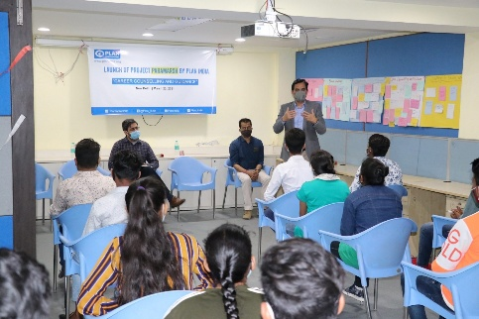
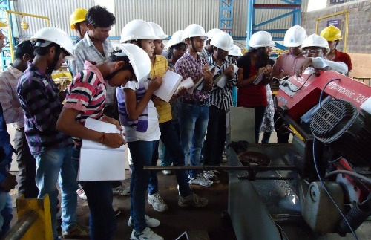



INNOVEXA 007
AI-Driven voice Assistant for livelihood Mapping and NSQF-Aligned Skilling Recommendations for SC Communities under GIA component of PM-AJAY
Problem
Proposed Solution
Beneficiaries under PM-AJAY struggle with text-heavy portals, enroll in courses that do not match local job demand, and once training ends there is no way to know who was placed or who dropped out.
VOICE INPUT
LIVELIHOOD PROFILE
OPPORTUNITY MATCH
OUTCOME TRACK
NSQF PATHWAY
FEASIBILITY CHECK
Skill & career guidance gap
Training - Livelihood gap
How we stand out
● ASPIRATION EXPANDER
Suggests higher-value adjacent trades beyond traditional family occupations
● OUTCOME-DRIVEN FOLLOW-UP
7 / 30 / 90 / 180-day check-ins track placement and flag early dropout risk.
● LOW-CONNECTIVITY ACCESS
IVR for feature phones + WhatsApp voice notes for low-data access.
Opportunity gap
.
Skill – job mismatch
Digital access barrier
System Workflow
IVR / WhatsApp / Kiosk
Voice input from beneficiary
Speech-to-Text + Language Detection
Converts regional speech into text
AI Profile Extraction
Extracts education, skills, experience, goals & constraints
Skill + Demand Matching Engine
Compares beneficiary profile with local jobs, enterprises & training
NSQF Recommendation Engine
Maps skill gaps to suitable NSQF-aligned trades & courses
Voice Response + Outcome Database
Explains recommendation through voice and stores follow-up outcomes

Slide 3

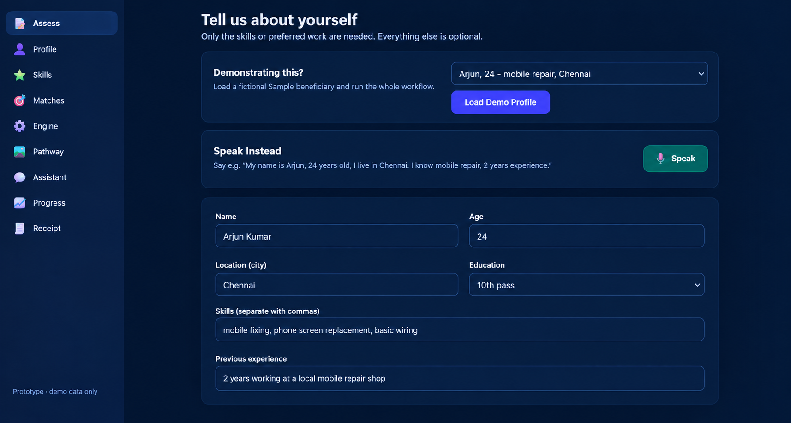


INNOVEXA 007
TECHNICAL APPROACH
SOFTWARE STACK
ARCHITECTURE OVERVIEW
React PWA → Simple visual navigation & Responsive Interface
Beneficiary (Speaks, Text)
Orchestration Module
Request Management
Python / FastAPI → Livelihood Engine & Backend processing
Browser Web Speech API (Speech-to-Text)
PostgreSQL + pgvector → Structured Database & Semantic Similarity Search
Authentication Module
OpenAI API / Hugging Face → LLM for Conversation & Structured Extraction
Core AI Livelihood Engine
Conversational AI
Skill Normalization Layer
LangChain / RAG → Contextualized Retrieval & Qualification Layer
RAG + Qualification Engine
Pathway Generation
Structured Extraction Layer Education Skills Constraints Livelihood
Skill Normalization Semantic
Explains Path + Gap + Next Action
Indic ASR / Whisper → Multilingual Speech-to-Text Input
Rules & Semantic Ranking
WebRTC → Low-latency Voice Communication
pgvector
Docker / Kubernetes → Containerized Deployment & Orchestration
PostgreSQL Database (Profiles, Cases, Audit)
Verified Opportunity Dataset
Authentication → Room Authentication & Secure Access
Dashboard
Cloudflare / CDN → Static Resource Delivery
Voice + Simple Visual Response
Beneficiary (Understands)
END-TO-END WORKFLOW
AI
Profile
Skill Normalization
RAG + Qualification
Livelihood Pathway
Outcome Tracking
Beneficiary Voice, Text
ASR
Beneficiary Receipt

Slide 4








INNOVEXA 007
FEASIBILITY AND VIABILITY
⚙️ FEASIBILITY
💡 VIABILITY
RISK & MITIGATION
Speech errors Confirmation + fallback options
Wrong recommendations Rules + explainable AI
Outdated data Regular data validation
Privacy risks Consent + secure data handling
Low adoption Simple local-language UX
Voice-first interaction
IVR • WhatsApp • Mobile
Technical readiness
Existing AI & speech technologies
AI-based profiling
Skills • Experience • Aspirations
Cost efficient
Open-source + low infrastructure
cost
Local opportunity mapping
Jobs • Training • Enterprise
Easy adoption
Simple voice-based interaction
IMPLEMENTATION READINESS
Development Ready
Deployment Ready
Low-connectivity support
Lightweight & cached interaction
Government compatible
Modular + API-based integration
Clean, modular code with proper structure and version control (Git).
Hosted on a live platform (e.g., GitHub Pages) with a public link.
User Testing
Security & Privacy
Checked on multiple devices and browsers for smooth functionality and responsiveness.
Basic security measures and safe data handling practices in place.
NSQF integration
Qualification & skill mapping
Scalable
More languages • Districts • Occupations
Maintenance Plan
Real-World Impact
Clear update process, bug fixes and future improvement roadmap.
Solves a real problem and is ready for actual users and usage.

Slide 5
IMPACT AND BENEFITS
INNOVEXA 007
STAKEHOLDER IMPACT
IMPACT = What changes
Increased accessibility
Beneficiaries
Personalized livelihood guidance
Training Ecosystem
Better training alignment
Better skill-to-opportunity matching
LIVELIHOOD ALIGNMENT
Clearer livelihood pathways
Implementing Agencies
Better case monitoring
Skills
Aspirations
Constraints
Programme Administrators
Actionable programme insights
Better pathway monitoring
BENEFITS = What users gain
Personalized Guidance
KEY OUTCOMES
HOW WE MEASURE IMPACT
Accessible
Voice-first interaction
Personalised
Skills + education + constraints
● Actionable
Clear pathway + next step
Trackable
Referral → Training → Outcome
●
●
Voice Access
Voice completion
Profile Quality
Profile completeness
Match Quality
Recommendation relevance
Follow-up
Outcome tracking
Relevant opportunities discovery
●
●
Clear next actions
●
Trackable progress
●
●

Slide 6
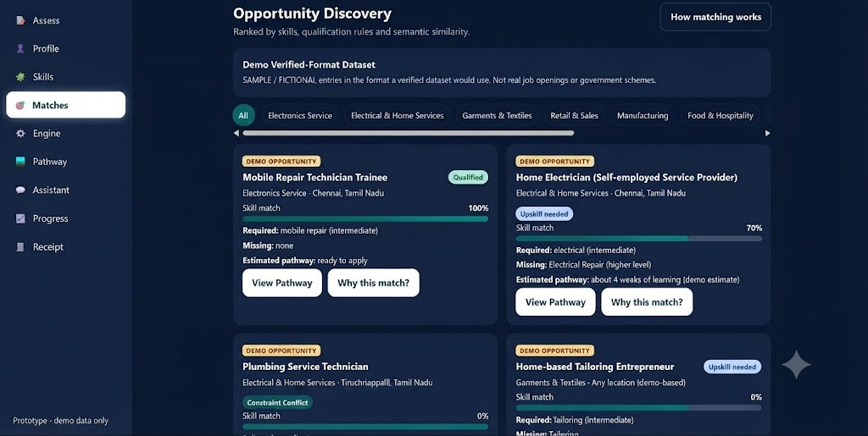
INNOVEXA 007
Research & References
Research
01 — AI-Based Job Recommendation
Personalized opportunity matching using skills, experience and preferences.
Case Study :-
YouTube :-
02 — Skill Gap Analysis
Identifying missing skills required for a target role or livelihood pathway.
Webpage :-
03 — Career Path Recommendation
Connecting a person's current profile with suitable future pathways.
04 — Knowledge Graph & Semantic Matching
Understanding relationships between skills, roles, training and opportunities.
05 — Training & Course Recommendation
Linking skill gaps with relevant learning and upskilling options.
Reference
Webpage
YouTube
Case Study
A Survey on Artificial Intelligence (AI) based Job Recommendation Systems, IEEE, 2023.
Machine Learning based Ideal Job Role Fit and Career Recommendation System, IEEE, 2023.
Development of a Knowledge Graph-Based Model for Recommending MOOCs..., IEEE Access, 2024.
Skill-Based Recommender System for Internship and Industry Hiring using Knowledge Graphs, IEEE, 2025.
AI-Powered Skill Gap Analysis and Career Path Recommendation System..., IEEE, 2026.
Prototype Outcomes

